Slide 1
Group presentation Online Retailer
Chan Hon Lam, Harris Lui Chun Wang, Winko
Lau Moon Ho, Kevin Hui Ho Wa, Philip
Lui Cheuk Hin, Vincent

Slide 2
Presentation outline
Service Blueprint
User Stories
Data Interface
Online Retailer Store (website demo)
Agile Project Development Plan
Q&A

Slide 3
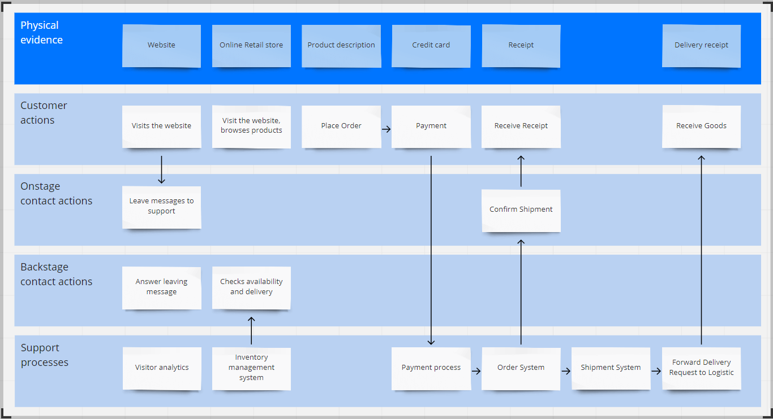
Service blueprint

Slide 4
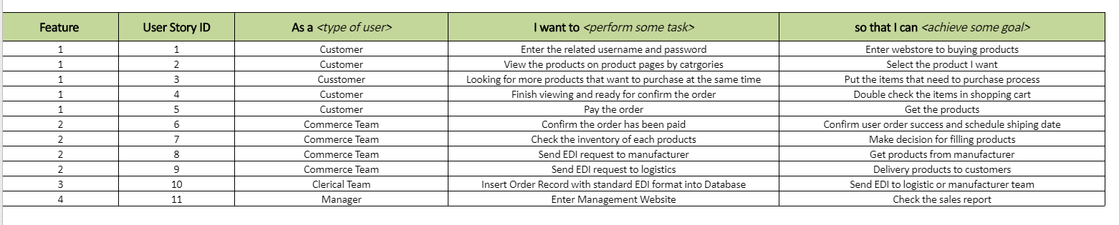
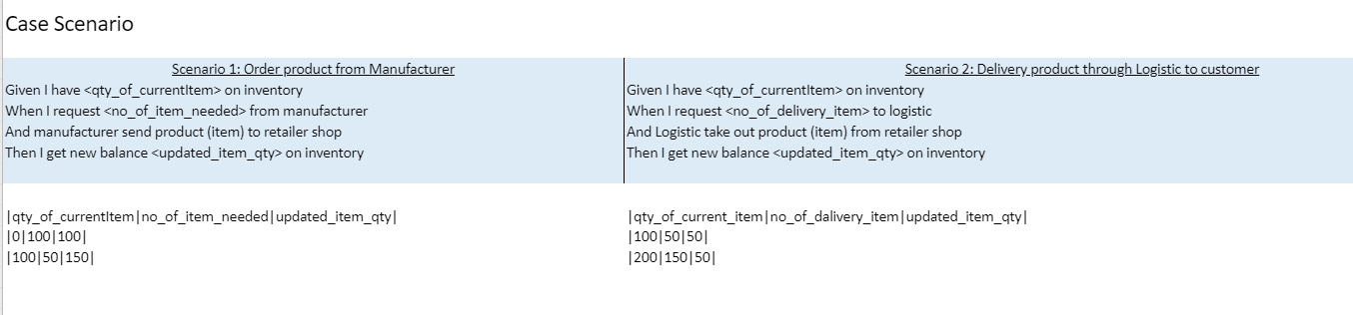
User Stories

Slide 5
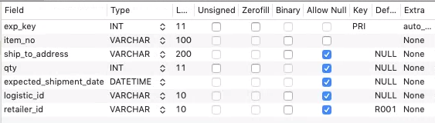
Export csv file to logistic team
Table Structure

Slide 6

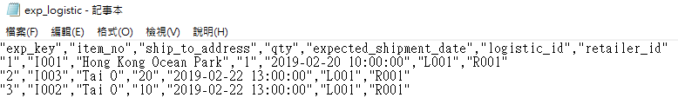
Export CSV File to logistic team
Sample Data
Output

Slide 7
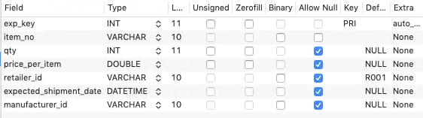
Export json file to manufacturer team
Table Structure

Slide 8
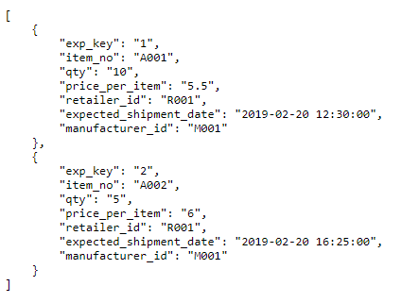
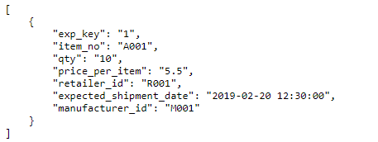
Export json file to manufacturer team
Output
https://302.winkoxd.com/manufacturer.php (Generate All Live Database Data)
https://302.winkoxd.com/manufacturer.php?expKey=1 (Generate Specific row)

Slide 9
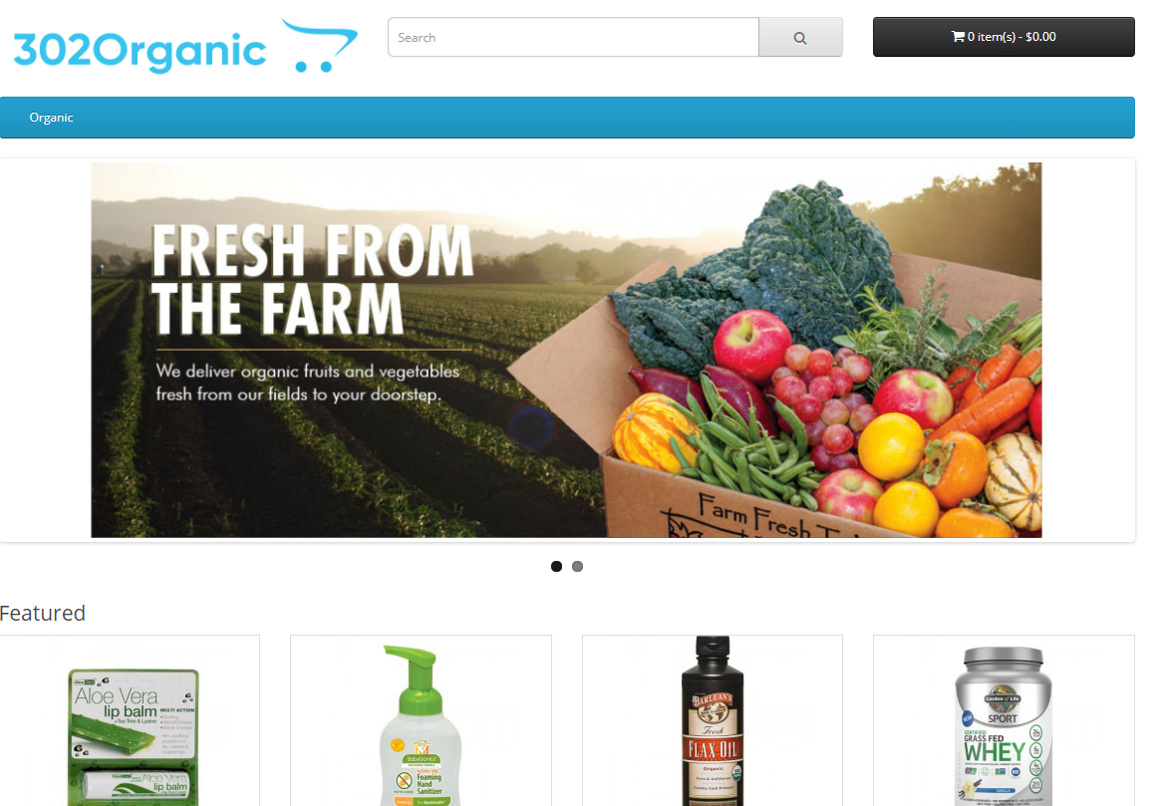
Online retailer store
Website Link

Slide 10
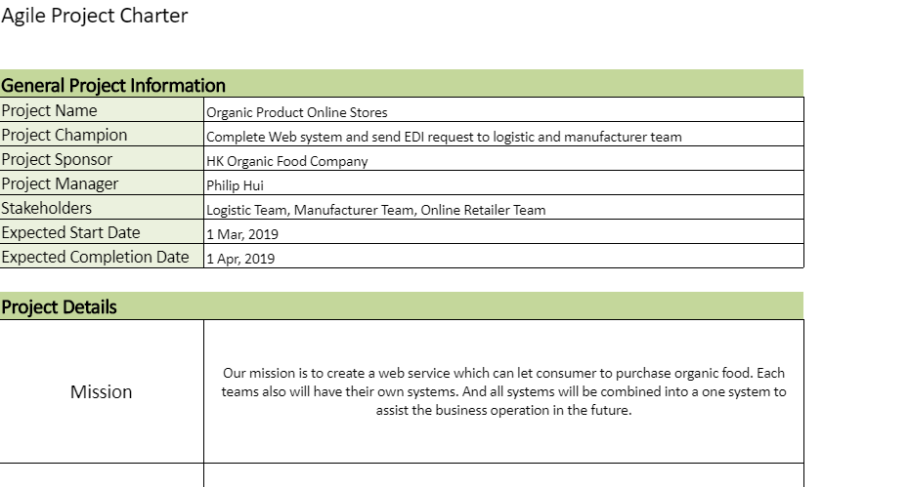
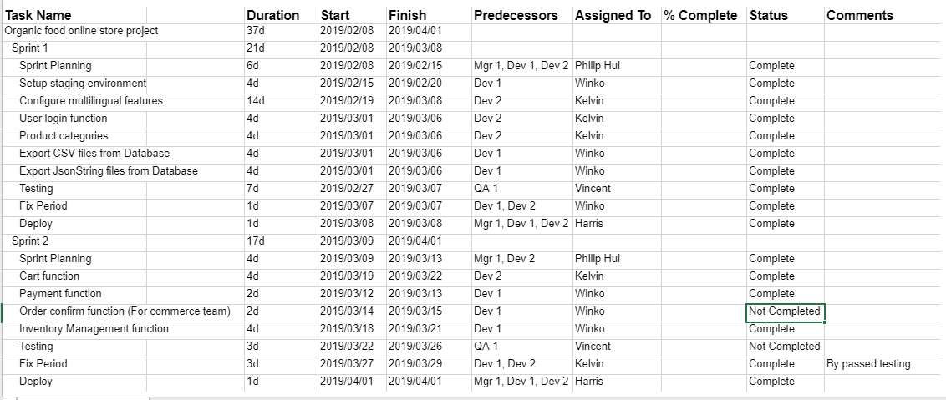
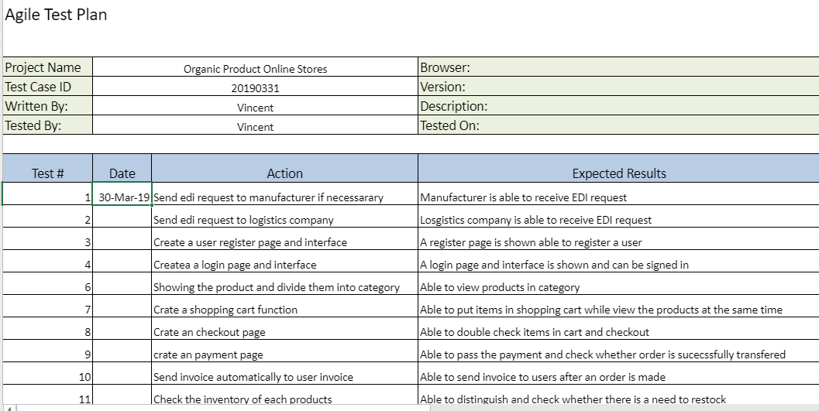
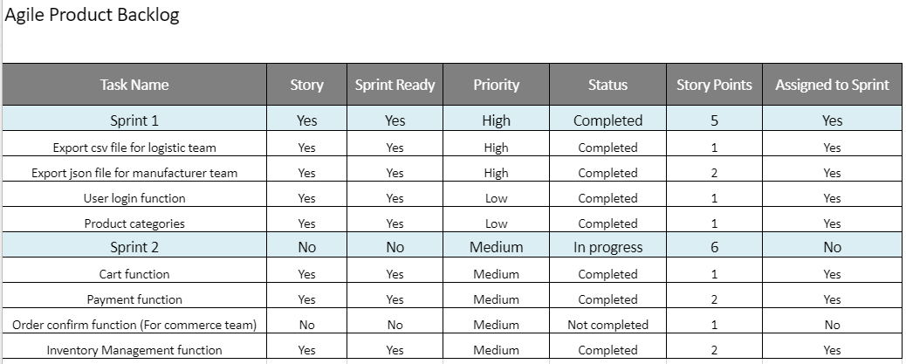
Agile project Development PLAN
Agile project planning

Slide 11
Q&A
Q&A session

